Slide 1



StudentLife
Presented By
Thuso Maebela

Slide 2

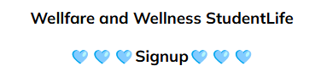
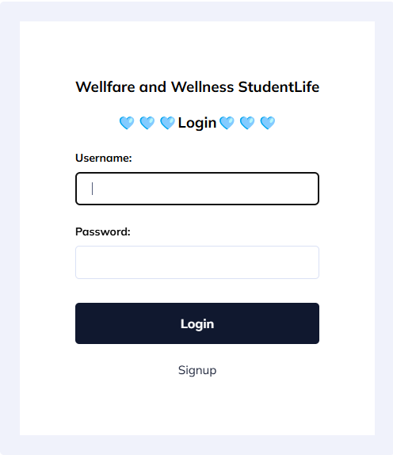
What is
StudentLife
"Wellness and Wellfare StudentLife" – an app that integrates study reminders, wellness check-ins, and productivity tracking.
Students often sacrifice sleep, meals, and breaks for academics, neglecting physical and mental health, leading to decreased focus, motivation, and academic satisfaction due to the absence of integrated wellness prompts.

Slide 3

Students often sacrifice sleep, meals, and breaks for academics, neglecting physical and mental health, leading to decreased focus, motivation, and academic satisfaction due to the absence of integrated wellness prompts.
Many students struggle with poor time management, leading to missed deadlines, inefficient study habits, and stress. Balancing assignments, exams, and personal wellness can be overwhelming, resulting in academic burnout.
Discovering
Requirements

Slide 4


INTERVIEWS
Tlhalefo
Has to constantly keep contacting family and family relatives because he is always forgetful with communicating and checking their well-being.
Always buys the wrong groceries and stationary when going shopping.
He is having trouble adapting to the academic environment and how to manage where he spends most of his time being.
Thabo
Has to constantly keep contacting family and family relatives because he is always forgetful with communicating and checking their well-being.
Always buys the wrong groceries and stationary when going shopping.
He is having trouble adapting to the academic environment and how to manage where he spends most of his time being.

Slide 5

PERSONAS &
SCENARIOS
Tlhalefo
Age: 19
Course: Dimploma in ICT
Challenges: Balancing projects, time management for studies, and job applications.
Needs:
A structured way to manage communications with people and when appropriate to do so.
Organized grocery list to manage shopping periods.
Thabo
Age: 22
Course: Diploma in Retail Business Management
Challenges: Struggles with remembering schedules, deadlines and assessments.
Needs:
Ability to create reminders for classes, tests and tasks.
Manage his personal life and work life while also not spending too much time organizing both his lifestyles.

Slide 6


Core
Functionalities
Smart Reminders
See the Due Date of reminders
The date and time of when the reminder was made.
Wellness Check-Ins
Create unlimited reminders for your personal needs.
You can delete a reminder if you’ve already finished doing it or if it’s been rescheduled.
Class Schedule Organizer
Displays upcoming tutorials, classes and assignments.
Shows you the date of your scheduled tasks and projects.
Organized display of reminders by arranging reminders with the closest deadline at the top of the homepage

Slide 7
INTERACTION TYPE
& INTERFACE METAPHOR
Instructing:
Users input study tasks, their description and due date.
Conversing:
Easy accessibility to see tasks and their description.
Manipulating:
Delete tasks when you’ve completed them or their date has passed.
"Personal Academic Assistant"
The app acts like a digital wellness monitoring coach and your very own varsity best friend.

Slide 8
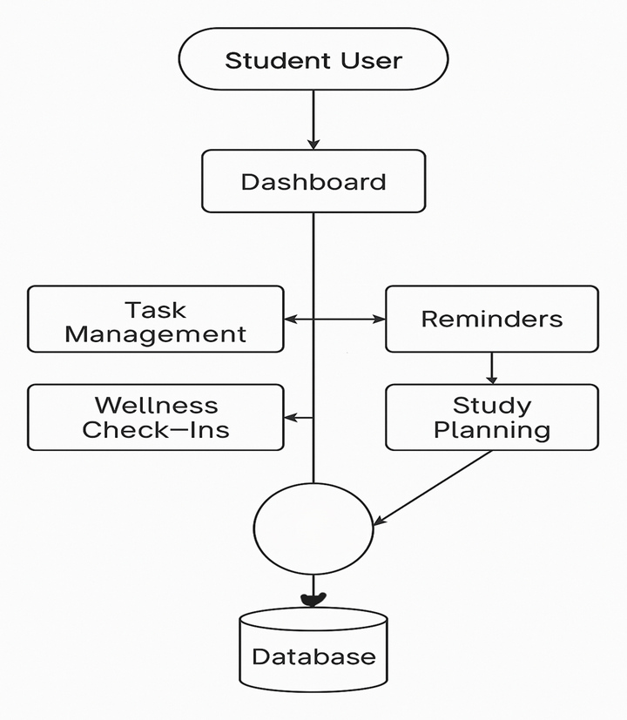
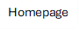

Diagrams

Slide 9
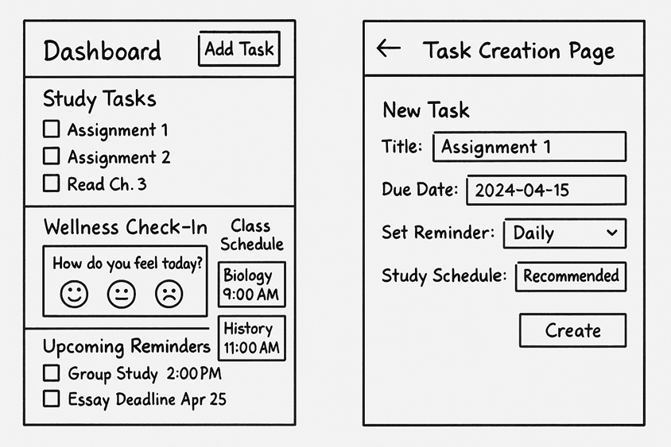
Sketches

Slide 10
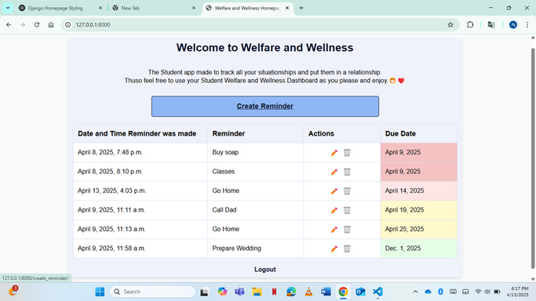
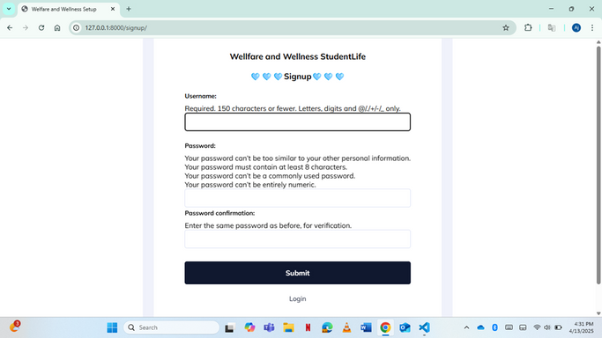
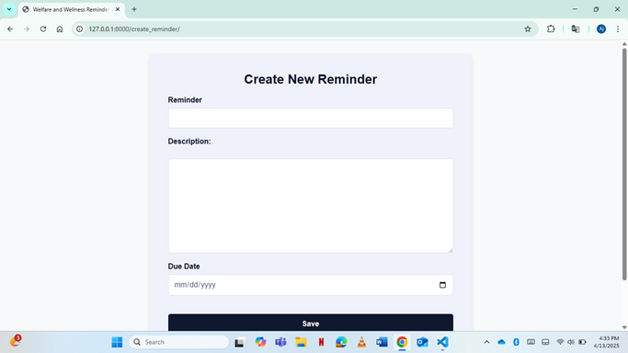
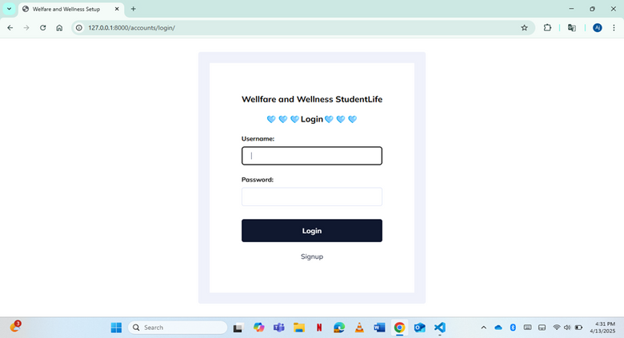
Screenshots

Slide 11

Evaluation
Planning
User Testing Questions
How easy was it to add and manage tasks?
Were the reminders helpful?
Did the reminders organizer improve focus?
What improvements would you suggest?
Evaluation Method
Creating a new reminder for an upcoming assignment.
Completing a wellness check-in.
Viewing and interpreting their upcoming class schedule.
Editing or deleting an existing task.
Usability & UX Goals
Usability Goal 1: Ensure ease of use – students should quickly add and track assignments.
Usability Goal 2: Ensure clear navigation – users must find key features without confusion.
UX Goal: Reduce stress by integrating wellness tracking & academic workflow management.

Slide 12

Reflections
Looking forward, I see great potential for evolving this app further — incorporating features like push notifications, calendar syncing, and even AI-driven study plans based on personal productivity patterns. Most importantly, this project reaffirmed the idea that good technology doesn’t just solve problems; it improves lives. By combining academic planning with wellness support, the app reflects a more holistic approach to student success. It’s not just about meeting deadlines — it’s about thriving while doing so.
Working on this assignment has provided a meaningful introduction to the real-world application of user-centered design principles. From identifying the problem space to conducting interviews and crafting personas, each step highlighted how vital it is to truly understand user needs before diving into development. The problem of student stress, poor time management, and difficulty in balancing academic and personal life is a universal challenge. Creating a digital solution like Wellness and Welfare StudentLife allowed me to explore how design can be both functional and empathetic.

Slide 13
Thank You

